Slide 1
Washington State Organization 2021-2026 Strategic Action Plan

Slide 2
Strategic action committee
Our deepest thank you to these fine women who worked for an entire year to bring this plan to the approval process:
Rayna Charles, Tau-Palouse; Rosa Eilert, Zeta-Wenatchee; Mary Lou Gregory, Beta Chi-Grays Harbor; Nancy Guthrie, Alpha-Tacoma; Teri King, Iota-Mason/Thurston; Mary Rennie, Theta-Yakima; Debra Tarpley, Alpha Delta-Seattle; Co-chairs: Janet LeBeau, Theta-Yakima; and Barbara Clausen, Chi-Cowlitz;

Slide 3
The process
Demographics of Washington women educators
Demographics of current DKG members
Chapter presidents survey results
Washington members survey results
International strategic plan
Research of resources at state & international level
Development of SMART goals, actions, accountability

Slide 4
A PLAN IS THE PLAN
When you plan for five years:
Use the road signs in the plan to guide you.
However, plan to adjust your GPS as the times change—the plan must be revised also!
UNTIL YOU HAVE A BETTER PLAN

Slide 5
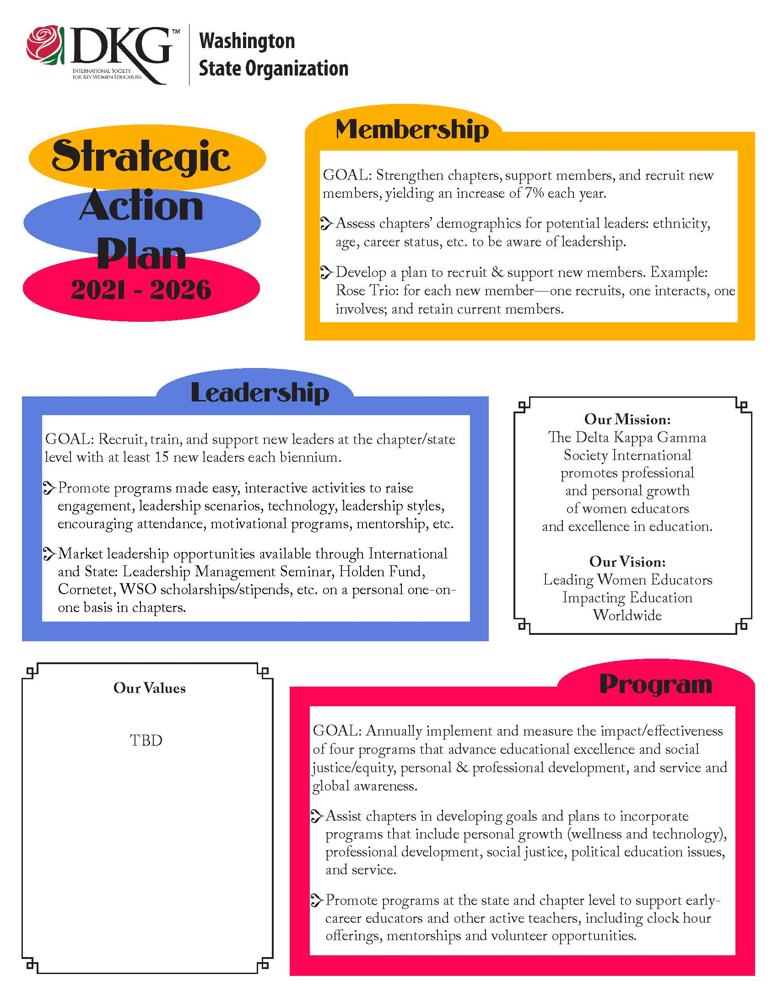
THE GOALS FOR FIVE YEARS

Slide 6
STATE TO CHAPTER SUPPORT
STATE COMMITTEE DEVELOPS TOOLS AND PRODUCTS
SENDS TO CHAPTERS FOR USE IF IT FITS THEIR CHAPTER
STATE COLLECTS CHAPTER ONGOING NEEDS, DATA OF EFFECTIVENESS OF TOOLS/PRODUCTS
MODIFIES THE NEXT YEAR’S SAP ACTIONS TO FIT THE CHANGING NEEDS BASED UPON ACCONTABILITY REPORTS/FEEDBACK

Slide 7
MEMBERSHIP
ACTIONS TO RETAIN/RECOVER MEMBERS AFTER COVID
ACTIONS TO HELP THE CHAPTER BECOME MORE VIBRANT
RECRUITING OF DIVERSE MEMBERS
USE OF INTERNATIONAL AND STATE RESOURCES

Slide 8
LEADERSHIP
How to support existing leaders in the chapter
How to assist in nurturing future leaders in the chapter
How to find fresh leadership in chapters for state leadership
How to support early educators from collegiate into employment

Slide 9
EEC Program
Provide prepared programs for chapters to use in four key areas:
Personal Growth / Technology
Social Justice
Political Advocacy Education, women children
Service state/local

Slide 10
SMART Goals/accountability
Measurable, relevant, specific goals with results reported back to the state on those items the chapter wishes to implement

Slide 11
Questions?

