Slide 1
Delta Kappa Gamma’s Resolution
“On Recognizing the Significance of Mental Health Issues for Educational Staff and Promoting Appropriate Support Services”

Slide 2
The Problem
73% of teachers report frequent job-related stress
27% of educators have symptoms of clinical depression
(compared to 10% of other adults).
Over 30,000 educators reported disrespect by elected officials, parents, students and the media. Bullying and threats contribute to their stress and anxiety levels
25% of teachers report they are likely to leave their job, compared to 16% pre-pandemic.
57% of teacher report seriously worrying about burn-out.
Notes:
These statistics are referenced in the resolution passed at the US Forum meeting last summer in New Orleans. The entire resolution is posted on the US Forum website: www.dkgusforum.org.

Slide 3
The Resolution: Increasing Mental Health Supports for Educators Four Action Verbs:
Educate yourselves on mental health issues and
needs of educational staff through study, workshops, other
Inform members of current legislation, take appropriate actions
Promote destigmatization of mental illness, share successful school-based treatment programs, supports, resources
Engage in activities that demonstrate emotional support for educators
Notes:
Education examples: the recent Zoom presentation on Teacher Burnout vs. ___ presented by the Illinois state organization and advertised on the US Forum website and Facebook pages, and the upcoming Dec. 1 Zoom presentation on Coping with the Holiday Blues with Dr. ____; find the Zoom link on the US Forum website and FB pages
Emotional support activities: mentoring, volunteering in classrooms, providing treats for teachers

Slide 4
Educate about the issues
Attend state and US Forum webinars and workshops
Investigate the OSPI website on secondary workplace trauma and watch training materials
Conduct listening sessions in local schools

Slide 5
Inform about legislation and take action with legislators
Familiarize self with recent and current legislation
Talk to/write your legislators
Write letters to the editor

Slide 6
Recent Legislative Action
HB1182 providing for 988 help line services (make mental health emergency responses more available)
HB1834 recognizing mental health as a legitimate excused absence for students; will benefit many, especially those with anxiety disorders.
HB 1664 increasing the staffing for support services (nurses, counselors, psych) will help make student services more accessible.
SHB1363 gives recognition to secondary traumatic stress, compassion fatigue, among educators

Slide 7
SHB 1363 Addressing Secondary Trauma in the K-12 Workforce
Sponsors: Rep. Ortiz-Self; Callan, Davis, Ramos, Simmons, Berg, Morgan, Bergquist, Harris-Talley and Pollet
Recognizes compassion fatigue in educators’ stress
Identifies symptoms
Preventable and treatable
Requires school districts to adopt policy & procedure to address secondary traumatic stress in the workforce, make resources on subject available to public, etc.
Approved by the Governor April 2021

Slide 8
SHB 1363 requires:
1. The Office of the Superintendent of Public Instruction (OSPI) to
Publish website links to resources, Self assessments, & best practices for educators and local policymakers
Collaborate w/ WSSDA, Educational service districts, & employees benefit board and provide links to resources on STS available through these organizations
Workforce Secondary Traumatic Stress | OSPI (www.k12.wa.us)

Slide 9
2. Wa State School Directors Association (WSSDA)- to develop or revise, and update, model policy and procedure to prevent & address secondary traumatic stress:
The policy must include:
Commitment to support mental health in workplace
Promote positive workplace climate with focus on diversity & inclusion
District wide workforce mental health committee to share resources,
Report to school distict board of directors 1x/year min
Regular assessment of district and school building level implementation- including workforce input
Provide appropriate resources & training to schools and staff for continuous improvement
Post model policy and procedure on WSSDA site by Aug 1, 2021
Updates publicly posted

Slide 10
3. School Districts-by 2021-22 school year must
Adopt policy and procedures that incorporate all elements of the WSSDA model policy (5515 and 5515P)
Establish a committee to oversee data collection, assessment, providing resources and training
Report annually on the status of m-h for staff to their boards

Slide 11
Resolution Enhancements
Asking for
Funding for Training for Education Staff as per 1363
grants to develop on-line training, clock hour offerings on wellness and responding to mental health concerns,
Allocation of funds to enable existing school mental health providers to also serve school employees.
Legislators hold “listening sessions” to hear directly from educators the nature of their mental health stressors and possible remedies.
Once we have some legislators willing to take on the enhanced bill, we will inform chapters and suggest ways your members can become involved.

Slide 12
What Can We Do Now?

Slide 13
Educate
Stay involved in your school district
Check if policy & model are implemented
Listen to teachers
Speak with your friends/community

Slide 14
US Forum connection
US Forum is divided into four Regions: NW, NE, SE, SW
Nancy Sheng (WSO) represents the NW states
US Forum Facebook pages, website: www.dkgusforum.org
Upcoming Zoom webinar: Coping with holiday blues Thursday, Dec 1, 4:30pm with Dr. Ellen Williams
Upcoming conferences in July 2023: Detroit and Phoenix
Spring 2024: National Legislative Conference in Washington, DC
Notes:
OSO – Oregon State Organization. Register for the Dec 1 webinar on the US Forum website and/or Facebook pages.

Slide 15
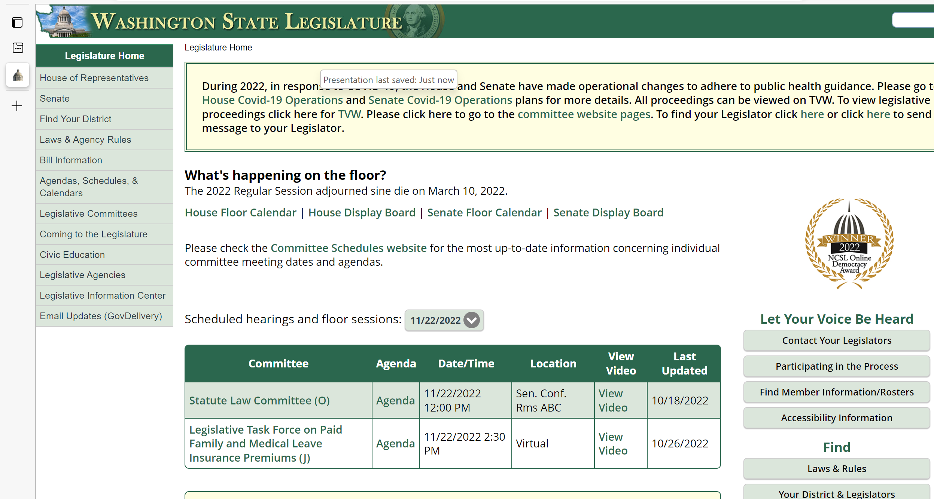
In form
Leg.wa.gov
Know your Elected Officials –Find Your District
Know the Legislation- Bill Information (1363)
Learn How a Bill is Passed –Civics Education

Slide 16
Inform and Take Action
Request meeting with legislator
Legislative buddy
Share Resolution info. sheet
Write, email, phone your legislator
Write letters to editor, etc.
Attend virtual hearings

Slide 17
Promote destigmatization
Share information on 988 and other resources perhaps as a book mark put in all educator boxes*
* requires collaboration with districts

Slide 18
Engage in activities to provide emotional support
Set up your own listening sessions in schools
Speak to school boards
Provide survival kits and other acknowledgements
Volunteer in schools

