Slide 1
Washington State Organization of DKG
2020 - 2022
Chapter Presidents

Slide 2
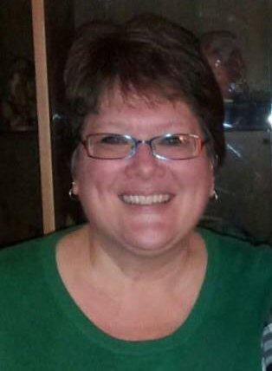
Alpha
Tacoma
Area 4
Laura
Bye

Slide 3
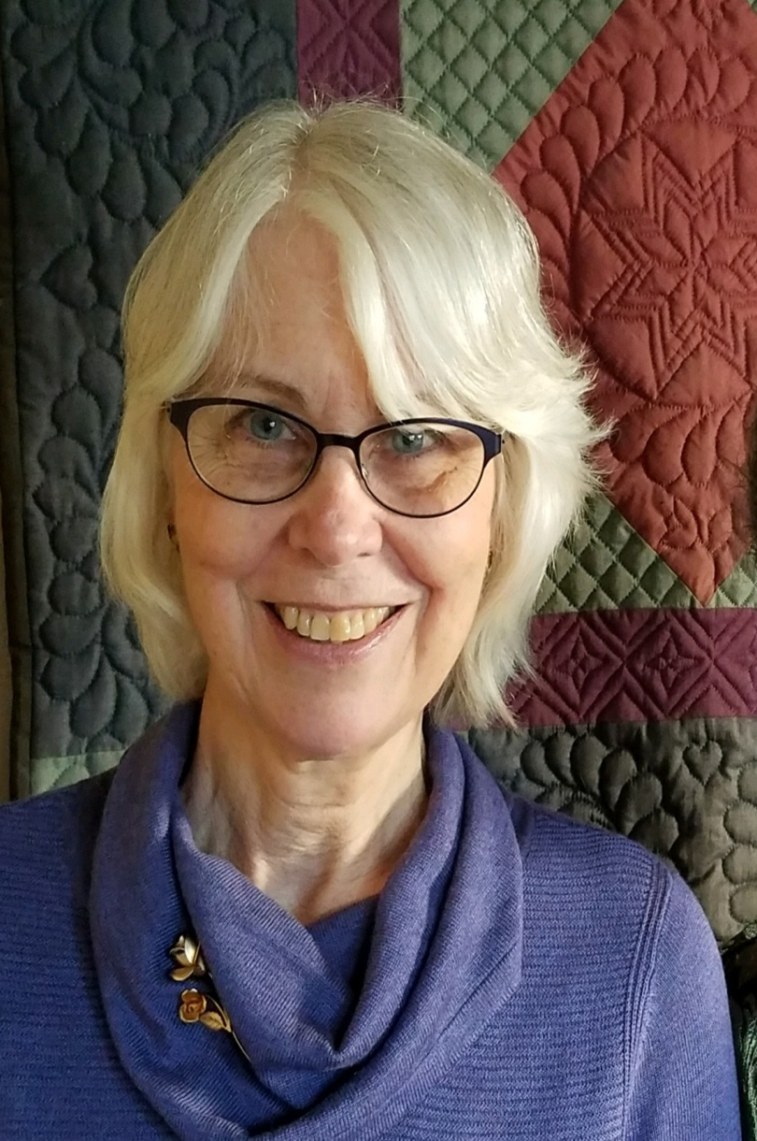
Alpha Delta
Seattle
Area 7
Kris
Hotchkiss

Slide 4
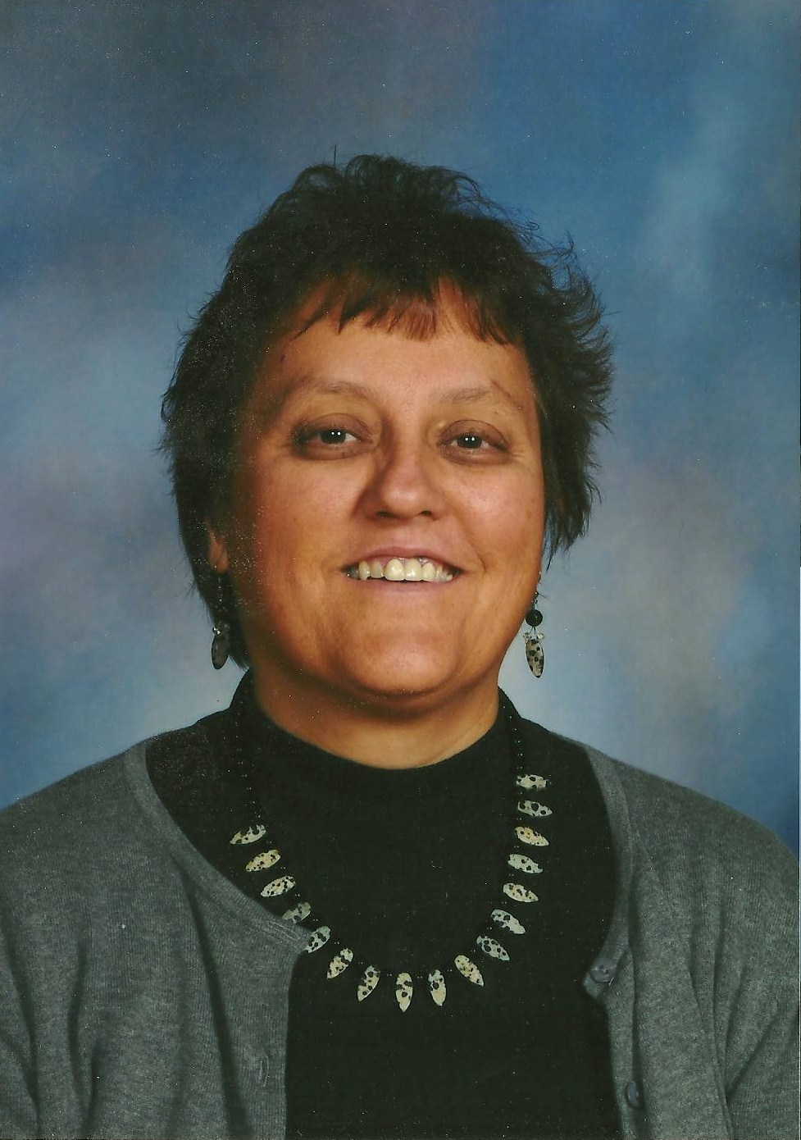
Alpha Lambda
Lower
Yakima Valley
Area 1
Robin
Smith

Slide 5
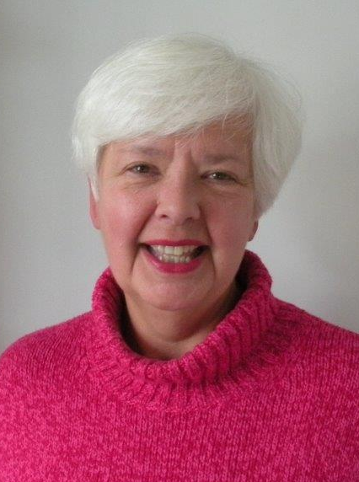
Alpha Nu
Seattle
Area 7
Garrel Lindberg

Slide 6
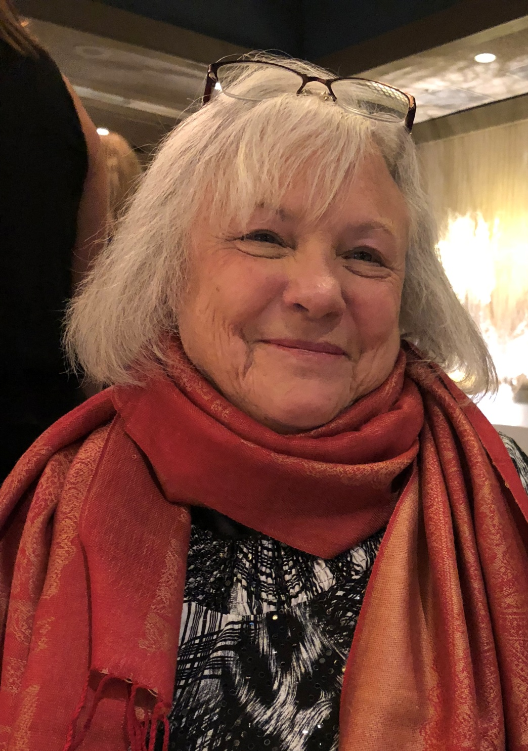
Alpha Psi
Pasco
Area 3
Ruth
Wolberg

Slide 7
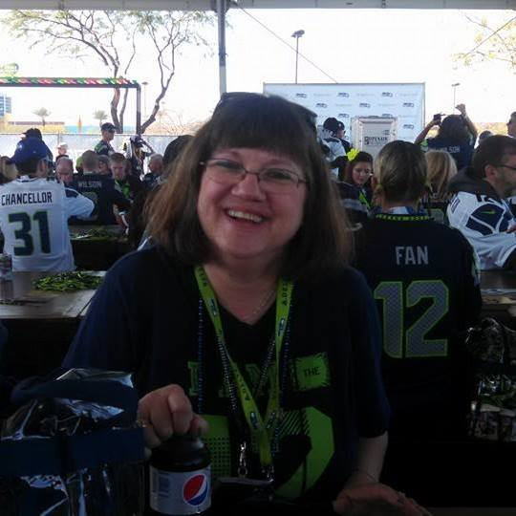
Alpha Rho
Spanaway
Area 4
Marian Barker

Slide 8
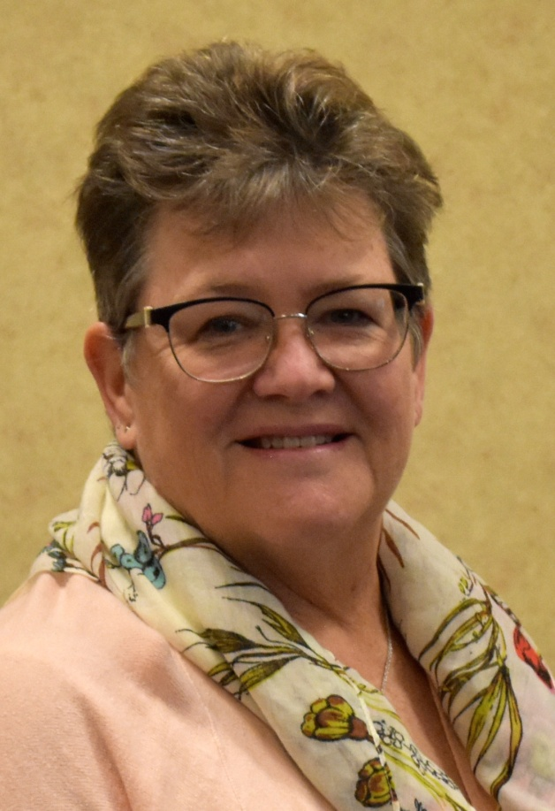
Alpha Sigma
Kitsap
Area 10
Andrea Neault

Slide 9
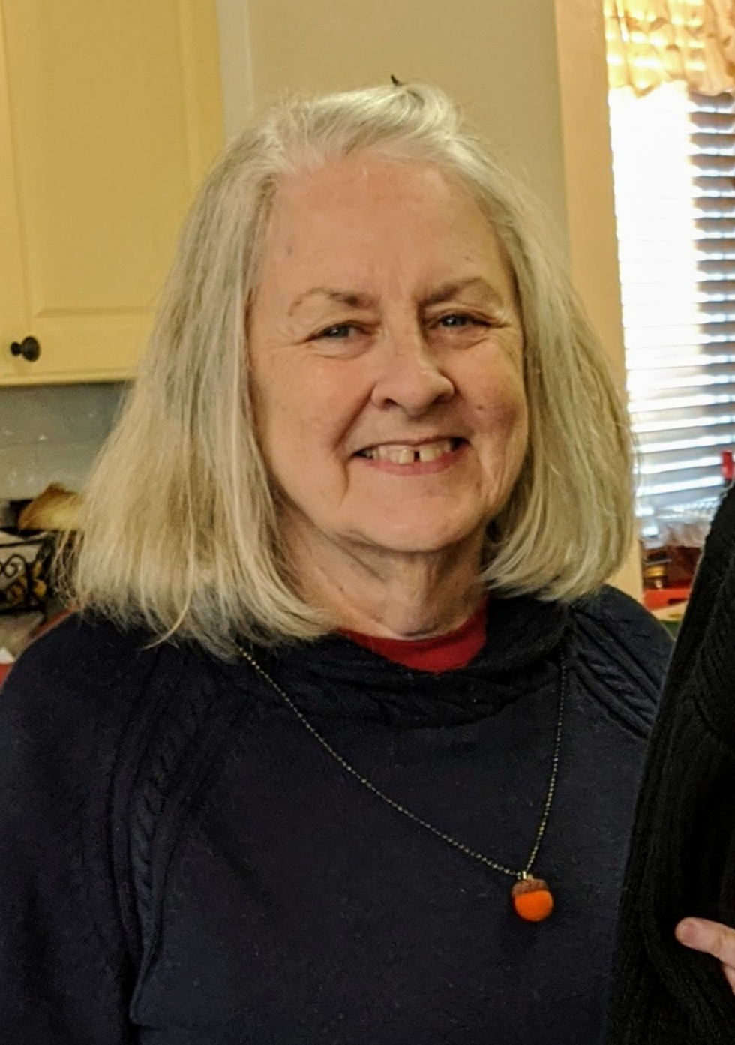
Alpha Tau
Tacoma/Puyallup
Area 4
Joan Schilling

Slide 10
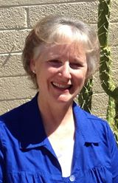
Alpha Zeta Goldendale
Area 1
Vicki Wollam

Slide 11
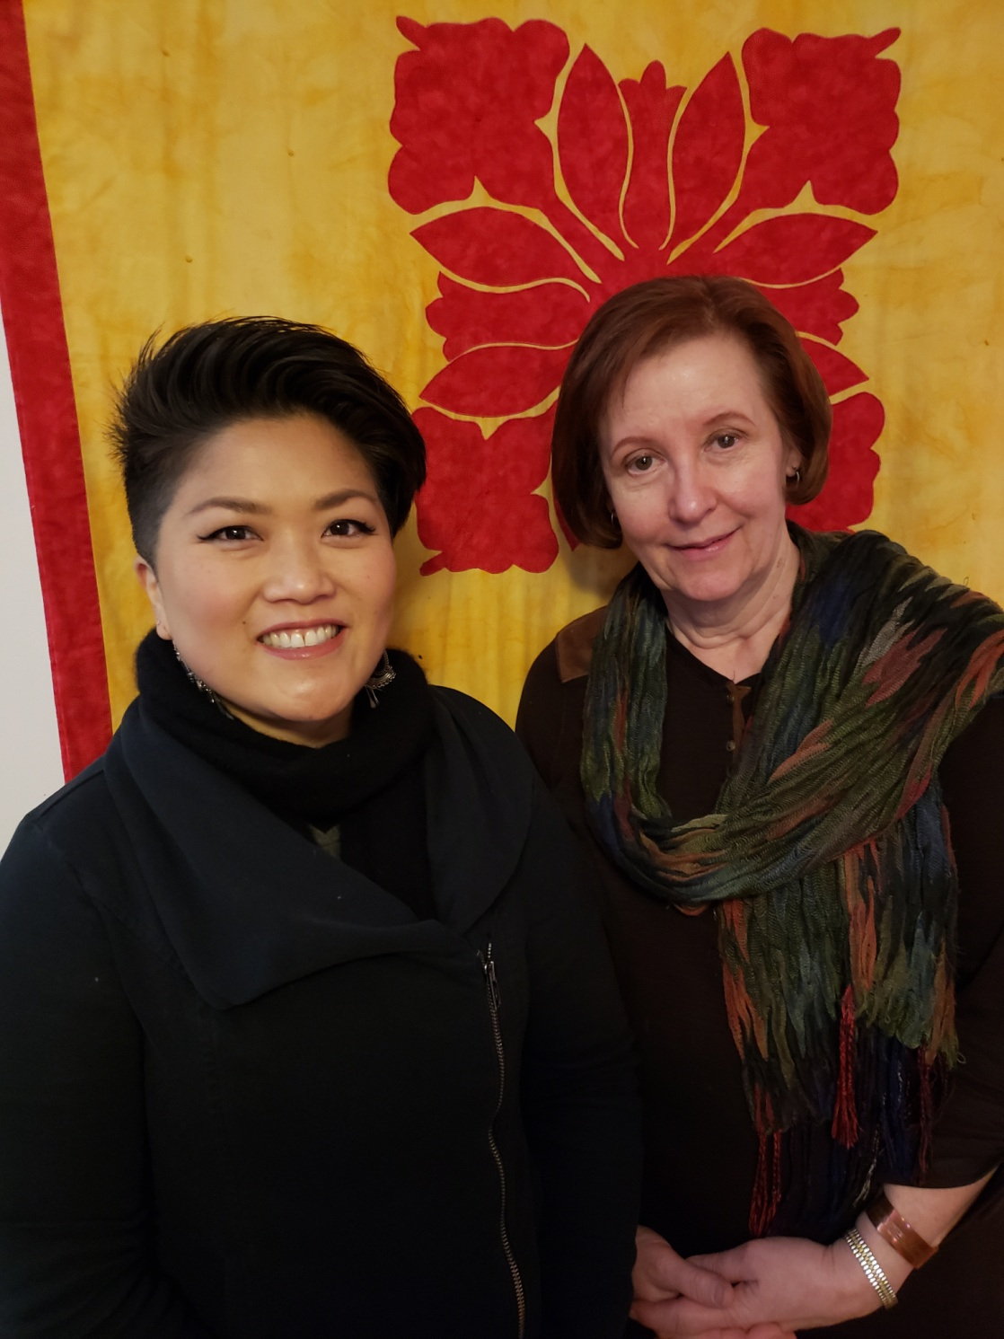
Beta
Seattle
Area 7
Paige Wilson
&
Kathy Kellogg

Slide 12
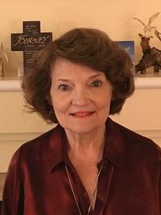
Beta Beta
Sea Tac
Area 7
Connie
Birkvold

Slide 13
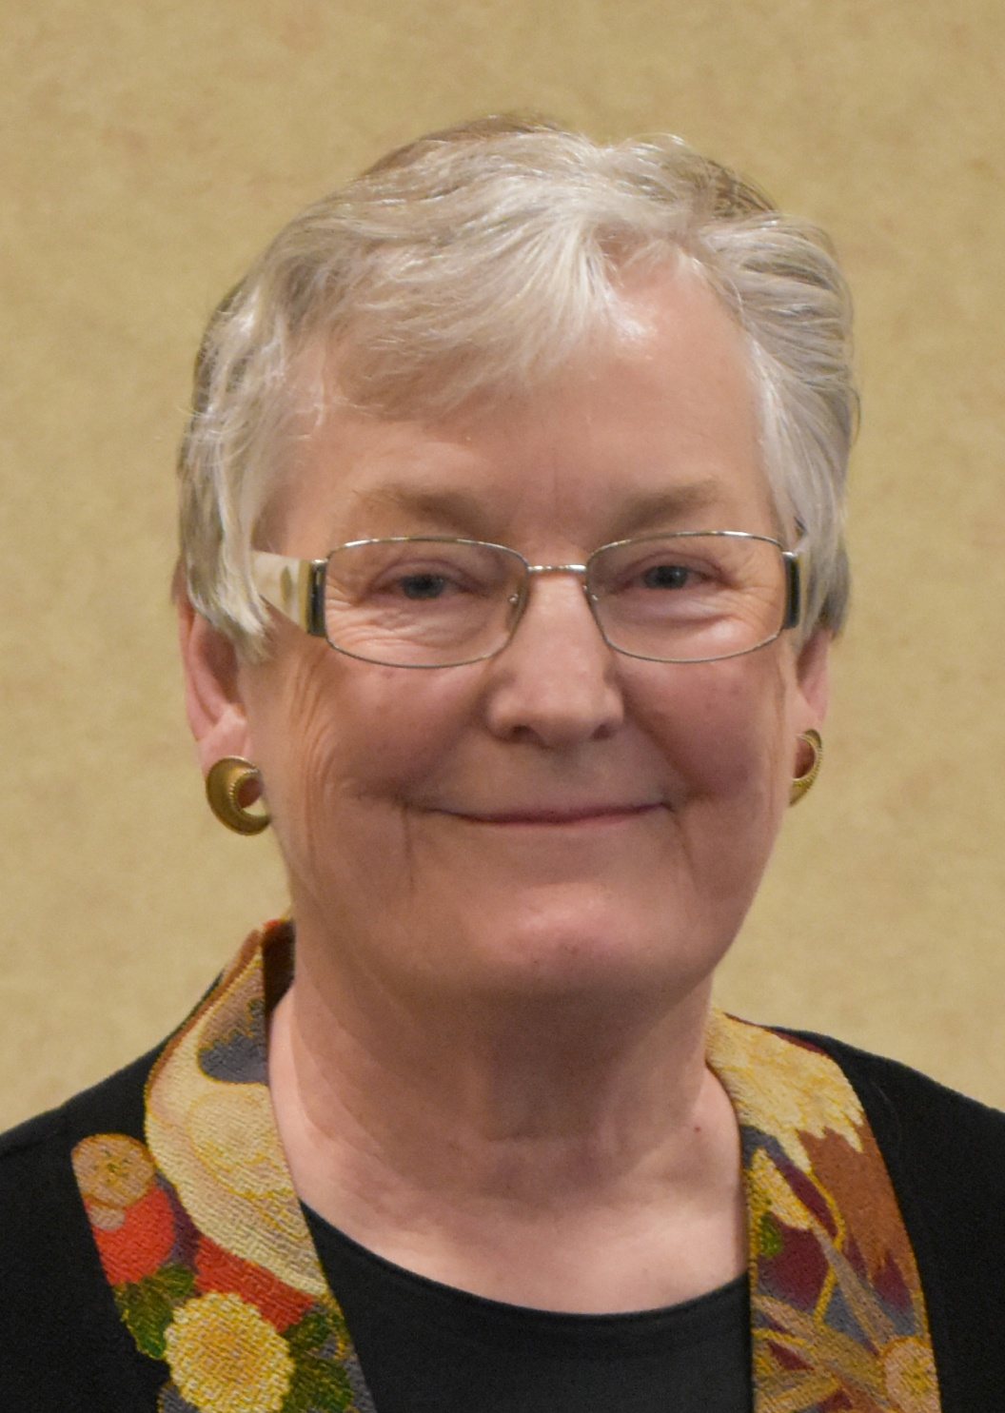
Beta Chi
Grays Harbor
Area 9
Mary Lou
Gregory

Slide 14
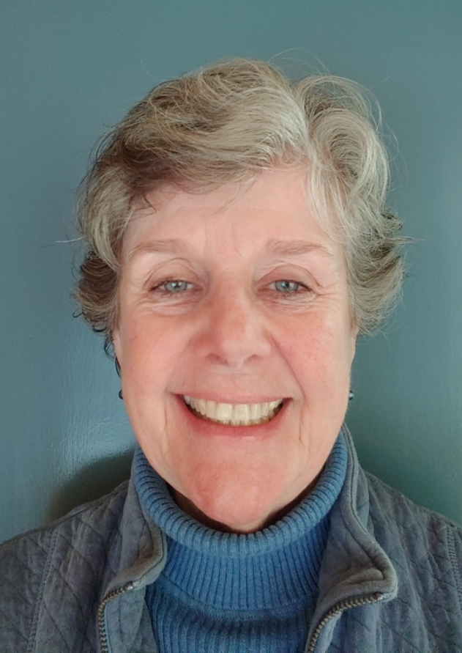
Beta Delta
Auburn
Area 4
Marge Lofstrom

Slide 15
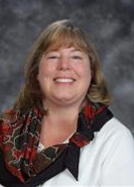
Beta Kappa
Oak Harbor
Area 6
Kris
Bishop

Slide 16
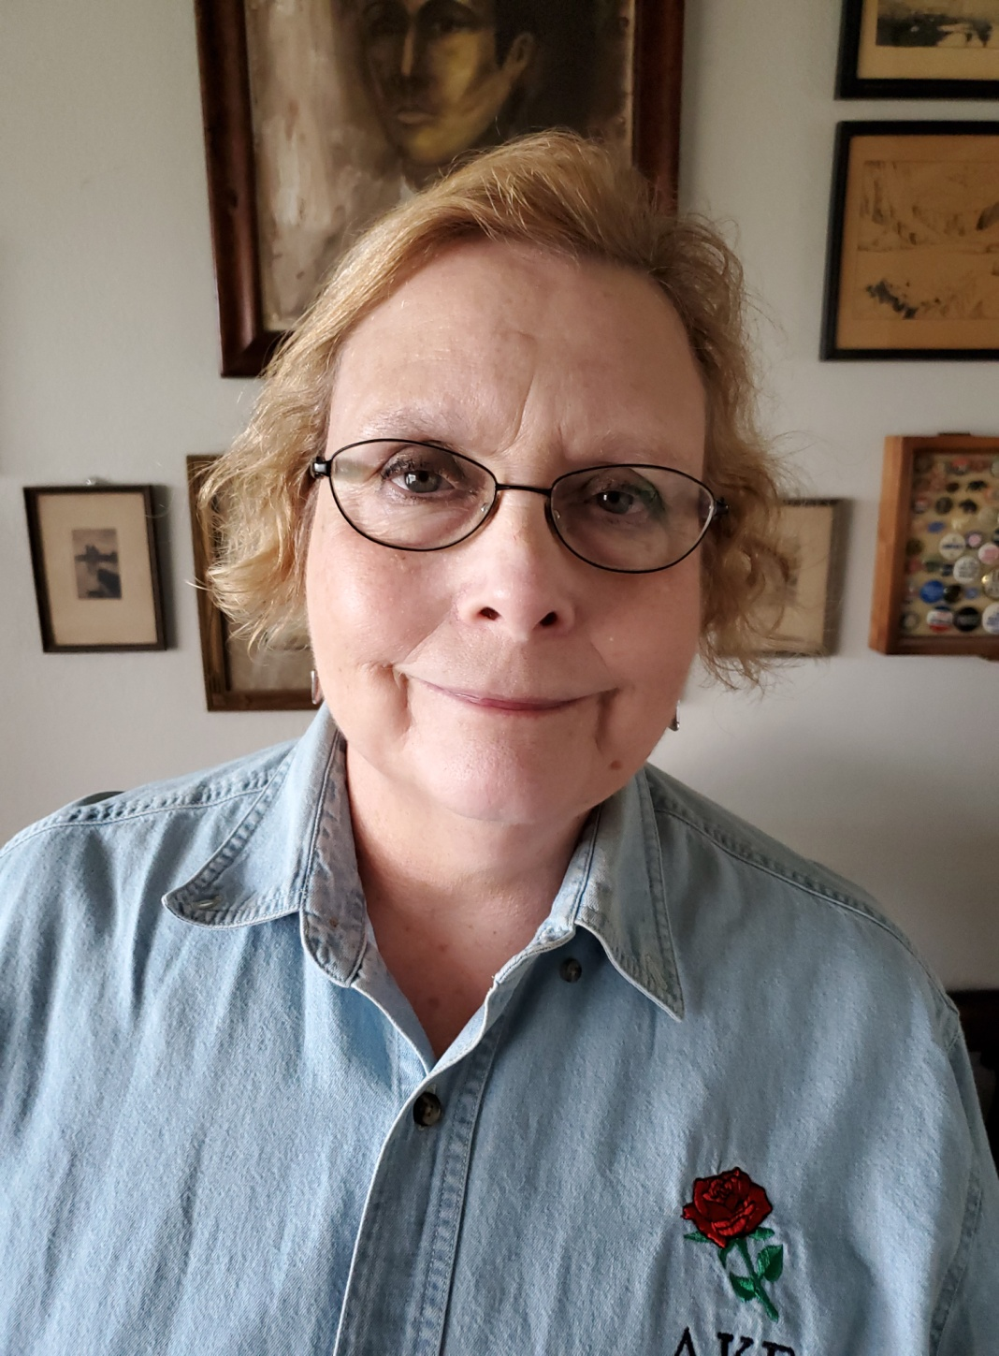
Beta Nu
Sequim
Area 10
Dodie
French

Slide 17
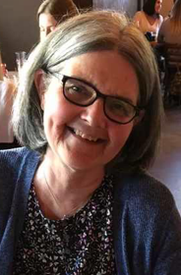
Beta Sigma
Seattle
Area 7
Rhonda Gardner

Slide 18
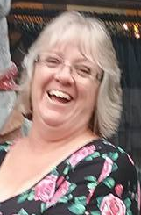
Beta Upsilon
Grand Coulee
Area 8
Caryn
Mills

Slide 19
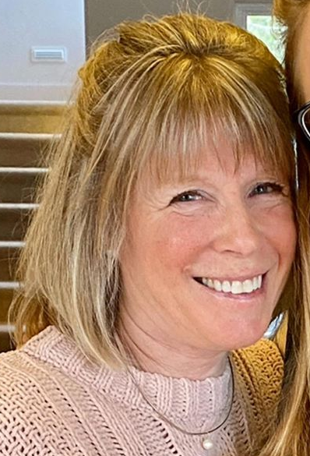
Chi
Cowlitz
Area 5
Deb Tulver

Slide 20
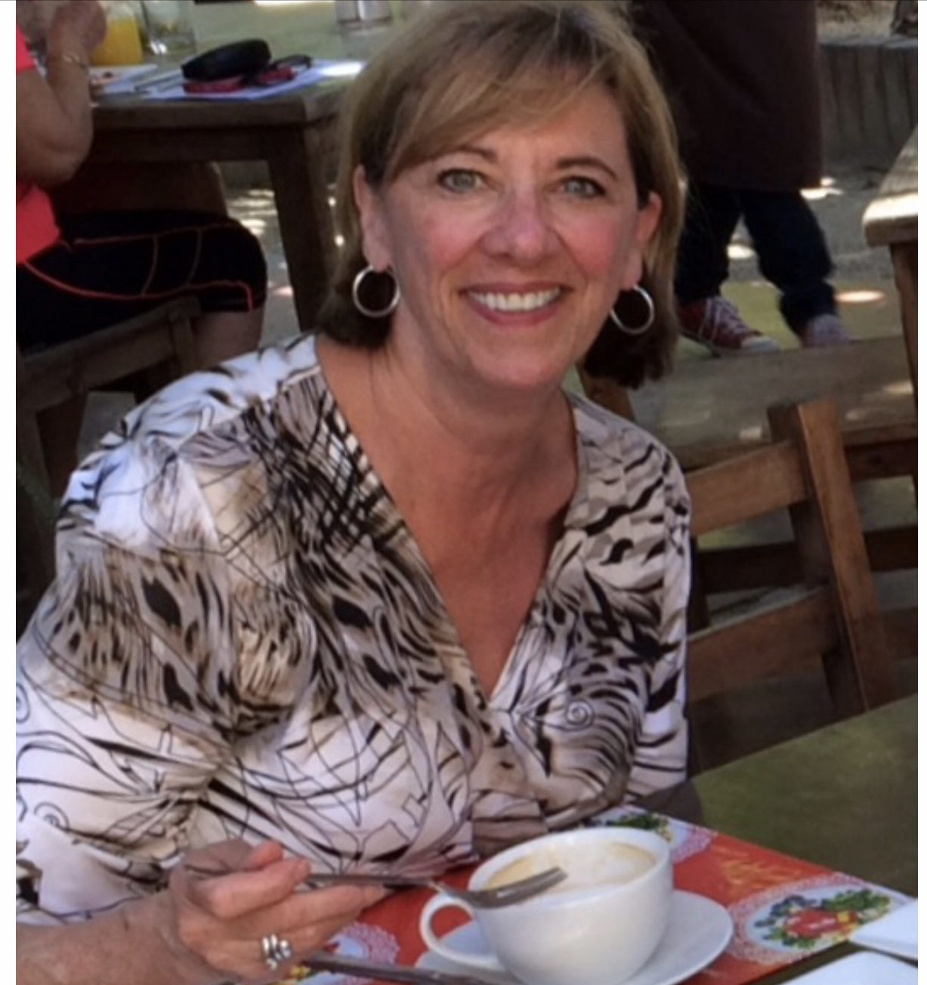
Epsilon
Puyallup
Area 4
Mariet
O’Leary

Slide 21
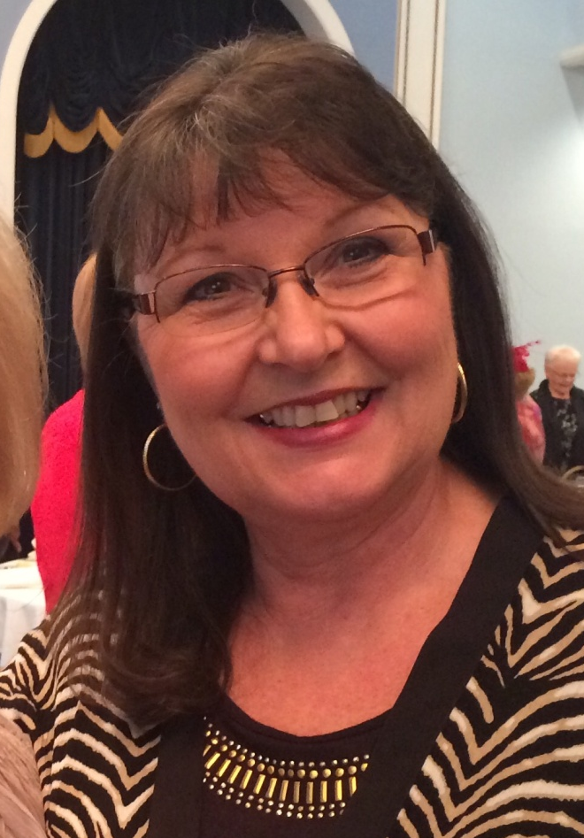
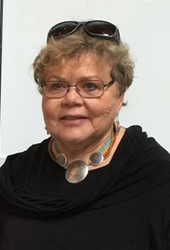
Eta
Spokane
Area 2
Sherri Wagemann
&
Tori Hanson

Slide 22
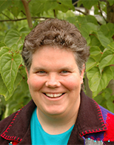
Iota
Mason & Thurston Counties
Area 9
Teri
King

Slide 23
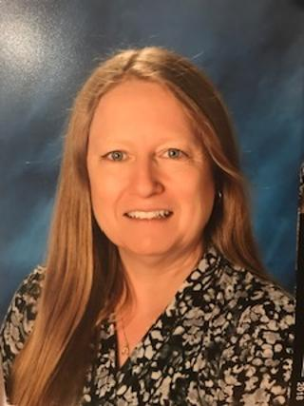
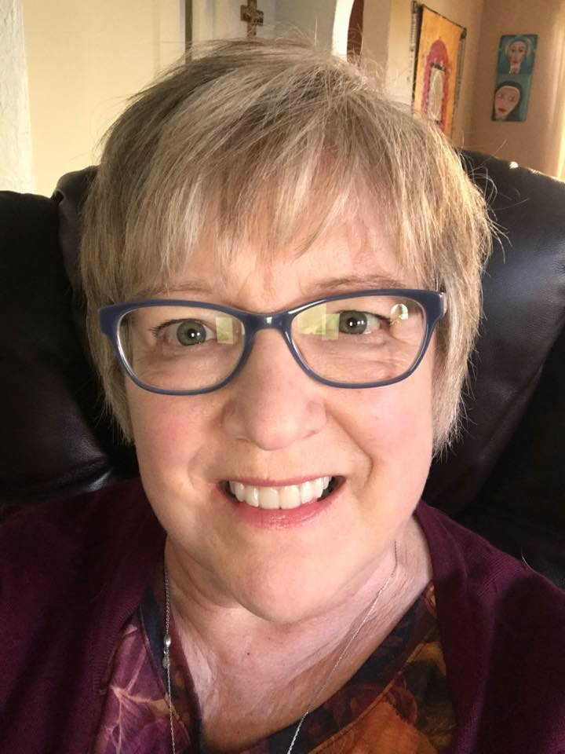
Kappa
Kent
Area 4
Kenda Chambers
&
Lynn Thompson

Slide 24
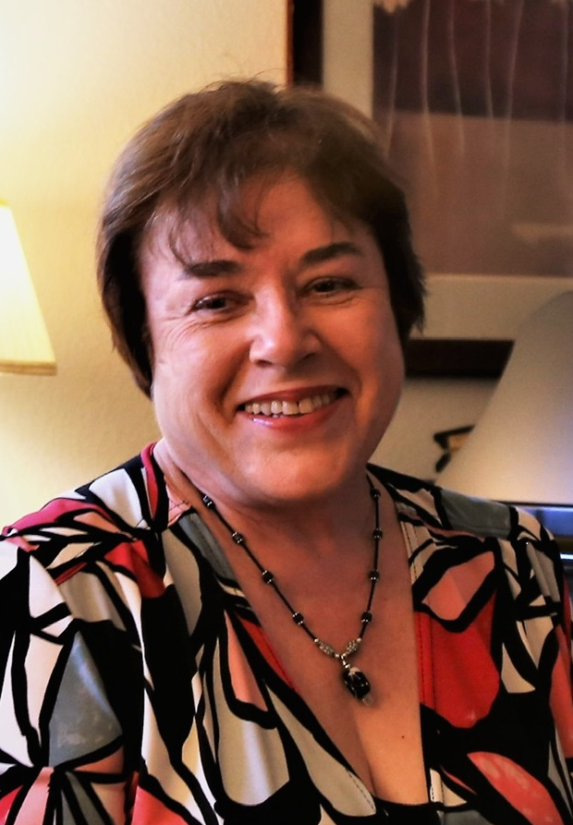
Lambda
Bellingham
Area 6
Nancy K.
Sheng

Slide 25
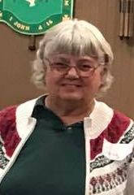
Mu
Vancouver
Area 5
Joy
Gault

Slide 26
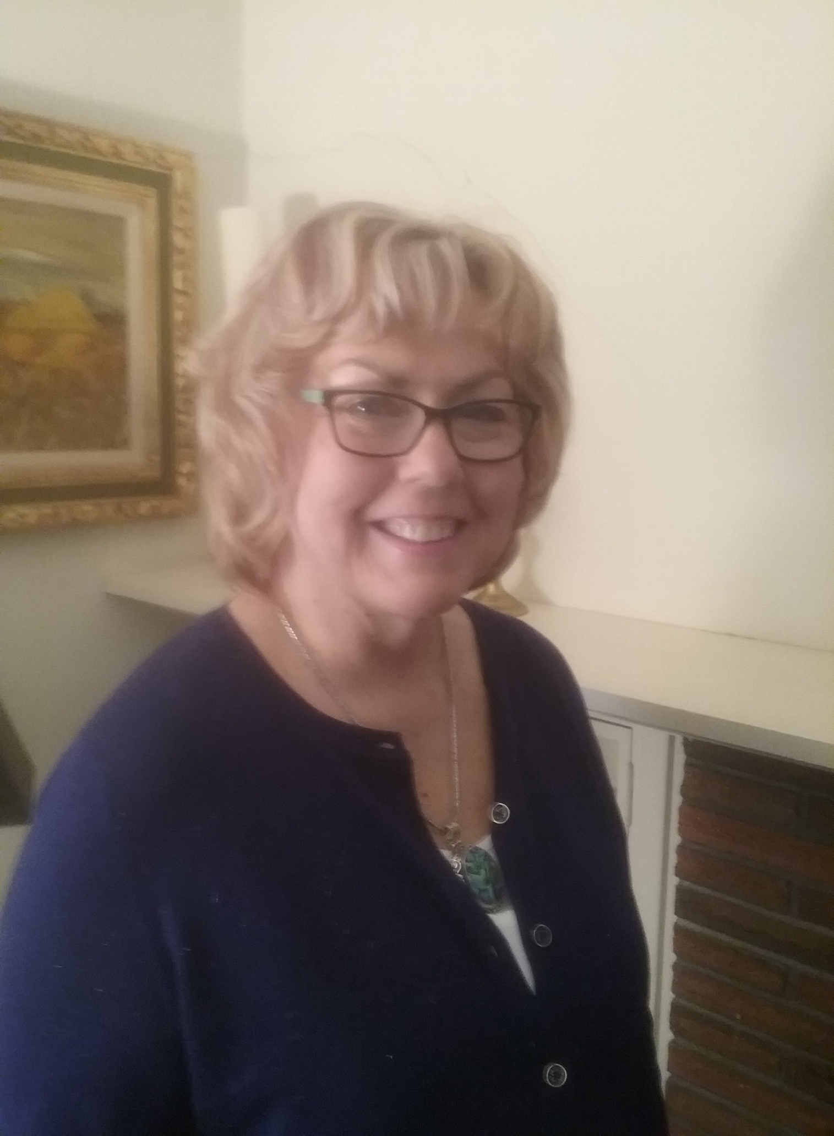
Phi
Grays Harbor/ Pacific
Area 9
Cheryl Hancock

Slide 27
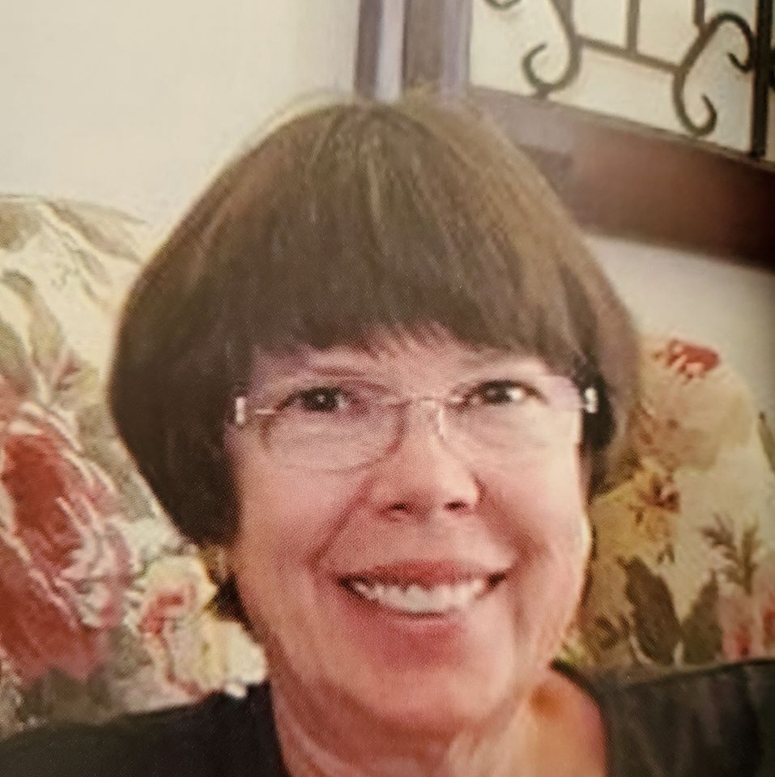
Psi
Kennewick
Area 3
Caryn Mears

Slide 28
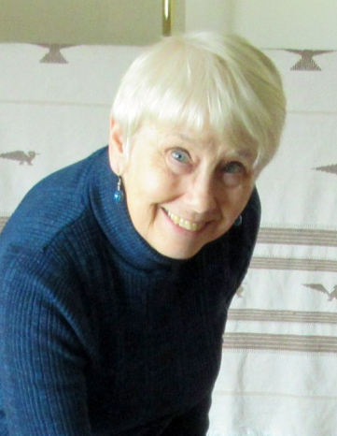
Rho
Seattle
Area 7
Beth Panattoni

Slide 29
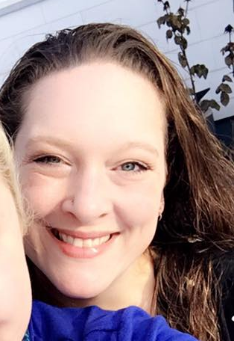
Tau
Palouse
Area 2
Rose Bruce

Slide 30
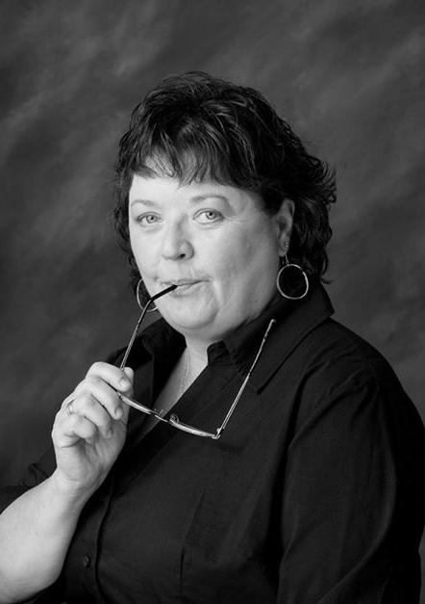
Theta
Yakima
Area 1
Mary Rennie

Slide 31
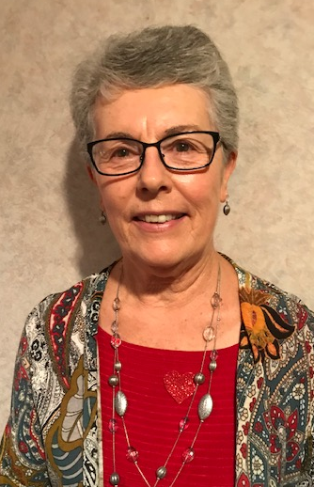
Zeta
Wenatchee
Area 8
Rosa Eilert

Slide 32
Thank you for your leadership!

